Slide 1


FIT9136 PASS WEEK 6
Introduction to Inheritance & Abstract Data Structures
2nd Sep 2024
CL_33 Innovation Walk, Room C107 / Online

Slide 2

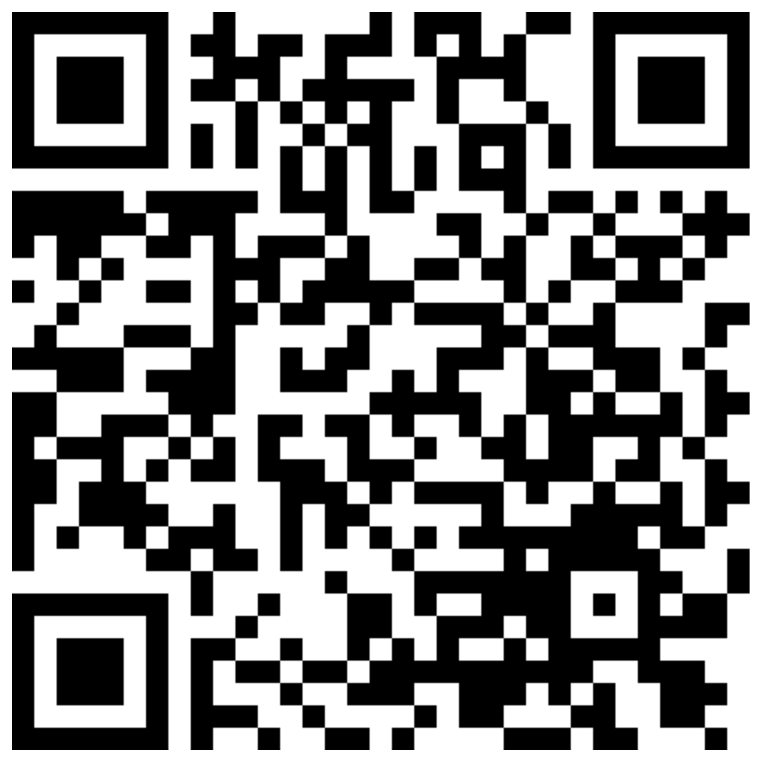
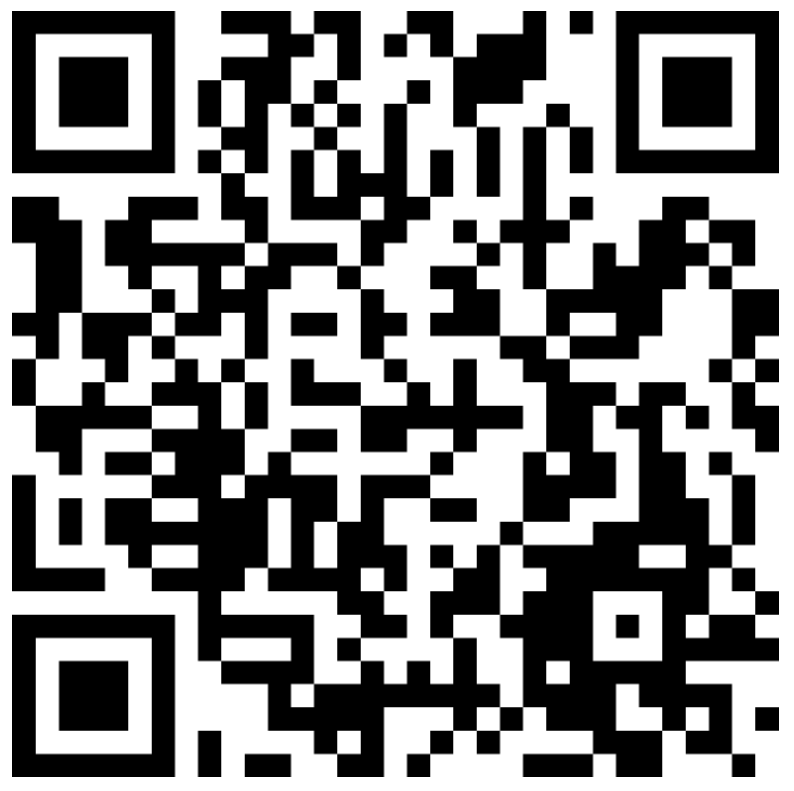
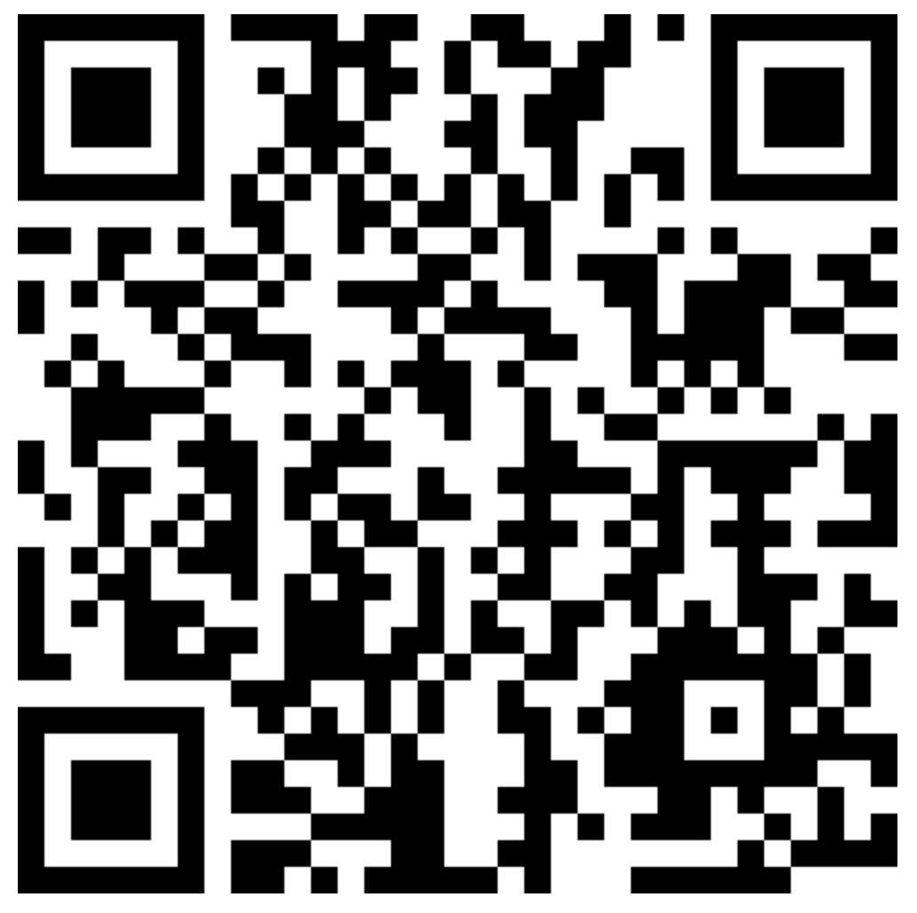

Attendance & Resources
Attending sessions is not mandatory but highly recommended.
Attendance is not assessed.
Any questions? Email me: harry.wang1@monash.edu
Also find the drive to receive the weekly slides: https://tinyurl.com/FIT9136-PASS
Monday 2-3pm
Tuesday 9-10am
Tuesday 4-5pm

Slide 3
Agenda
01
Inheritance & Abstract Data Structure- 10 mins
Concept recap + practice + solution
02
Practice * 2 - 35 mins
03
Closure speaking - 15 mins
Conclusion + Q&A + Attendance recording

Slide 4
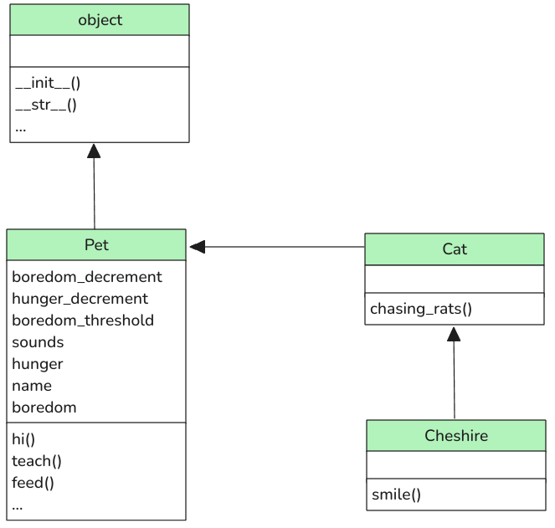
Inheritance
1. Code Reusability
• Definition: Inheritance allows you to create a new class that is based on an existing class.
• Benefit: This means that you can reuse code that has already been written, avoiding duplication and making the codebase easier to maintain.
2. Hierarchical Class Structure
• Definition: Inheritance allows you to create a hierarchy of classes, where more specific classes inherit from more general ones.
• Benefit: This helps in organizing your code in a logical way, where general behavior is defined in the parent class, and specific behavior is defined in the child classes.
3. Method Overriding
• Definition: A child class can override a method from the parent class to provide a more specific implementation.
• Benefit: This allows child classes to customize or extend the behavior of parent classes without altering the parent class itself.

Slide 5
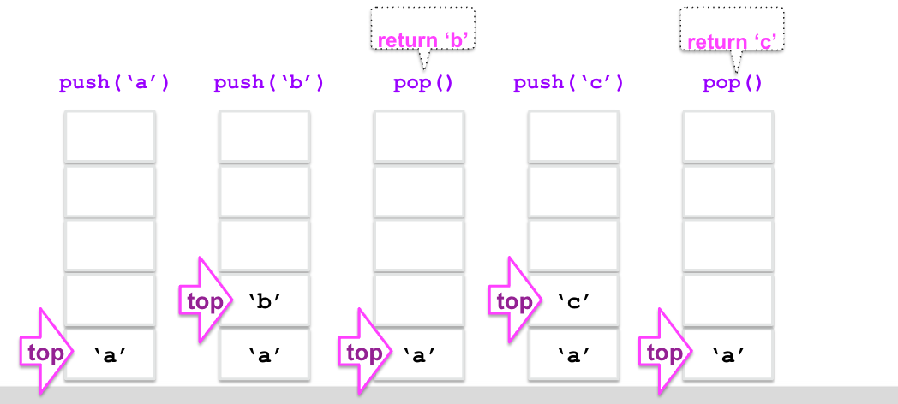
Abstract Data Structure
Stack:
LIFO (Last-In-First-Out)
Push()
Pop()

Slide 6
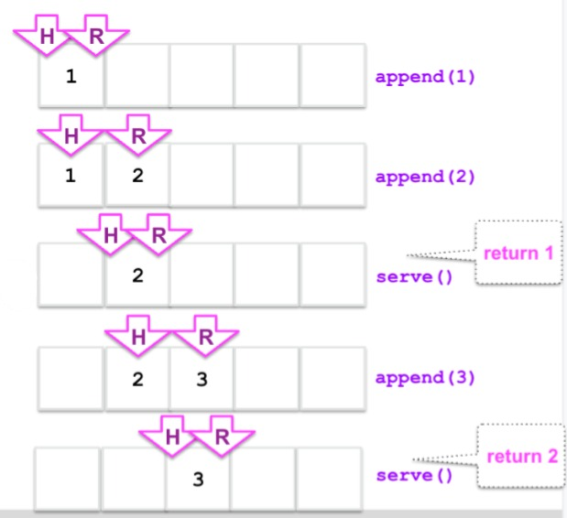
Abstract Data Structure
Queue:
append()
serve()

Slide 7
Practice 1
Base code: https://tinyurl.com/FIT9136-PASS/code/practice_1.py
You are tasked with creating a system to manage different types of employees in a company. The system should be able to handle different kinds of employees (e.g., full-time, part-time, and contractors) and calculate their salaries based on specific rules.
Requirements
1. Base Class: Employee
• name: The name of the employee.
• employee_id: A unique identifier for the employee.
• The Employee class should have a method called calculate_salary() that returns 0 (to be overridden in the derived classes).
• The Employee class should have a method called display_info() that prints the employee’s name and ID.
2. Derived Classes: Specific Employee Types
• Full Time Employee: Inherits from Employee and has an additional attribute annual_salary. The calculate_salary() method should return the monthly salary based on the annual salary (i.e., annual_salary / 12).
• Part Time Employee: Inherits from Employee and has an additional attribute hourly_rate and hours_worked. The calculate_salary() method should return the salary based on the hours worked multiplied by the hourly rate.
• Contractor: Inherits from Employee and has an additional attribute contract_amount. The calculate_salary() method should return the fixed contract amount as the salary.

Slide 8
Practice 1
How to organize the management system
Separate data and methods for future use

Slide 9
Practice 2
Please find the base code here: https://tinyurl.com/FIT9136-PASS /code/practice_2
Solution is also provided for comparison with the original code
Description could be accessible here: https://tinyurl.com/FIT9136-PASS /code/practice_2_desc
Understand the strength of using OOP and inheritance

Slide 10
Practice 2
How do child class inherits the parent class
super()
Call parent method
Override
Separate the file (files organization)

Slide 11

Let’s see what we got today
How to use inheritance?
What is stack and queue?

Slide 12
Attendance & Resources
Attending sessions is not mandatory but highly recommended.
Attendance is not assessed.
Any questions? Email me: harry.wang1@monash.edu
Also find the drive to receive the weekly slides: https://tinyurl.com/FIT9136-PASS
Monday 2-3pm
Tuesday 9-10am
Tuesday 4-5pm

Slide 13
Thank You
2nd Sep 2024
CL_33 Innovation Walk, Room C107 / Online

Slide 14
Questions & Answers
2nd Sep 2024
CL_33 Innovation Walk, Room C107 / Online

